Slide 1



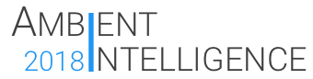
Nice To Meet You
Group 7
Ambient Intelligence Course
A.Y. 2017-18
https://ami-2018.github.io/NTMY/

Slide 2
Introduction
NTMY team

Slide 3
What is NTMY
NTMY is an Ambient Intelligence system that aims to help students in university residences to meet new friends by letting the users organize thematic events.
The goal of the project is to build a system that can be used in university residences to smartly organize events in order to let people meet others with the same interests. For this purpose, it makes use of different kinds of electronic devices such as PCs, mini computers, smartphones and wearables, all of which contribute to solve different problems that can be experienced during the organization of an event.
- Taken from Vision and Goal

Slide 4
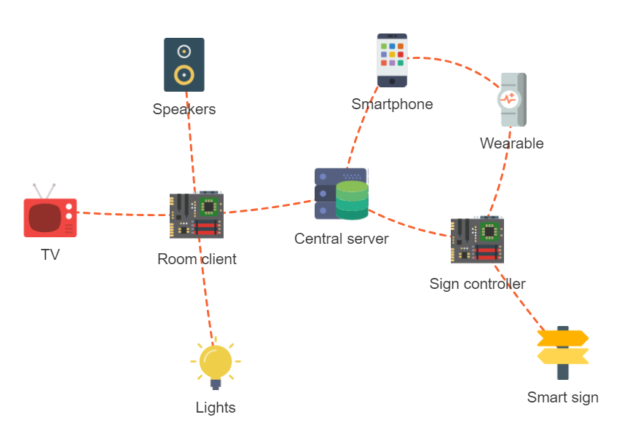
System architecture

Slide 5
NTMY Team
Alessio Ciarcià
SW developer
Matteo Corain
SW developer
Andrea Cossio
HW developer
Raffaele Tuzzo
SW developer
Wear app
Panel app
Server app
Client app
Smartphone app
Panel design
Panel app

Slide 6
Server architecture
Matteo Corain

Slide 7
Server main functions
Data storage
The server stores all the data regarging the users, the events and the rooms
Events allocation
The server is capable of the smart allocation of the rooms based on the events’ characteristics
API interface
The server presents an HTTP REST API-based interface to communicate with the other components of the system

Slide 8


Data storage
Uses Python SQLAlchemy support library, with SQLite as the database backend
Manages data about users, rooms, events and their relationships
The data model is organized in several subpackages, all containing classes whose objects are mapped from and to the database

Slide 9
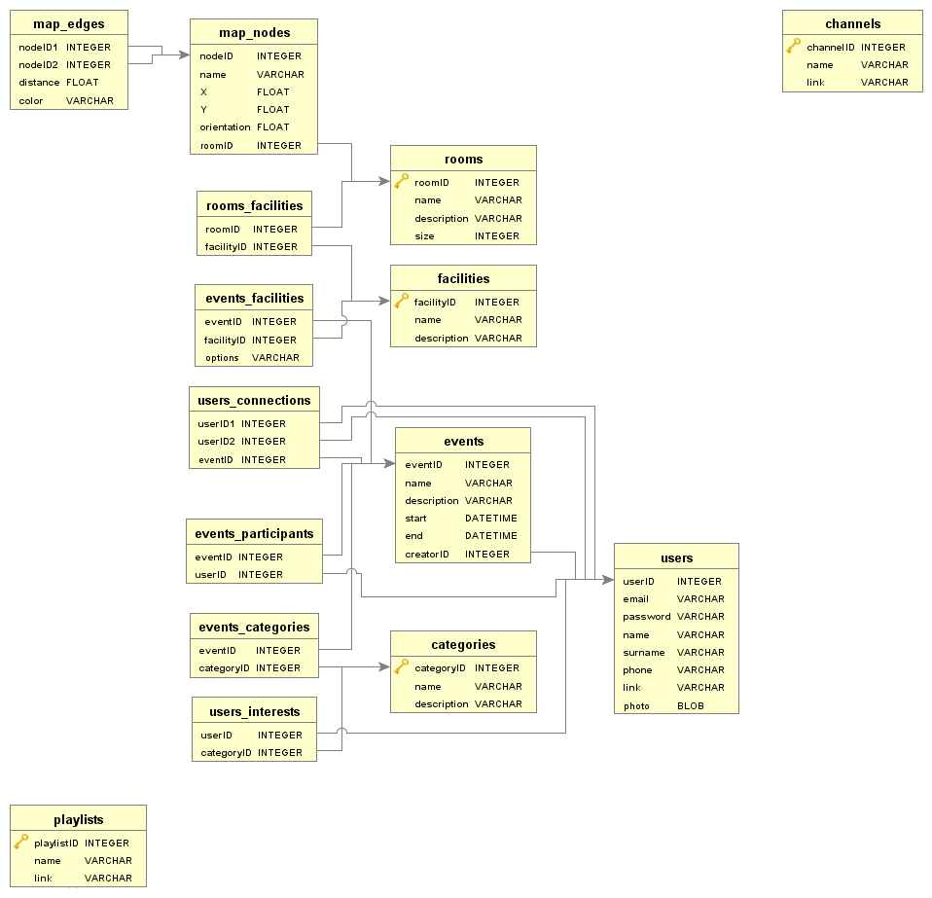
Data model
Main components:
Package standard:
User, Room, Event
Category, Facility
Package relationships:
UserConnection, EventParticipant
EventFacility, RoomFacility
EventCategory, UserInterest
Package map:
Node, Edge
Package media:
Channel, Playlist

Slide 10
Events allocation
Generates the daily schedule matching rooms and events
Uses a brute force optimization method
It is capable of optimizing different target functions
Makes sure that events fit the rooms and don’t overlap
Run asynchronously in a separated thread

Slide 11
Allocation process
The allocate_rec function generates all the permutation of n integers (being n the number of the rooms, considering also 0 as the special value meaning «the event will not be scheduled») in k position (being k the number of the daily events) via recursion techniques
Once a permutation has been calculated, a DailySchedule object is generated; if the schedule is valid (events fit the assigned rooms and do not overlap), it is passed to the TargetFunctionsSet object
The TargetFunctionsSet calculates the value of all the TargetFunction objects for the given schedule and compare them with the ones of best solution found until that point
If the schedule is better, the best solution is updated and, at the end of the process, the best daily schedule overall is produced

Slide 12

API interface
Uses Flask as the HTTP server
Exposes APIs to access data about users, rooms, events, media contents, graph nodes
Access to data is restricted only to registered users
Designed using the Google Developers guidelines

Slide 13
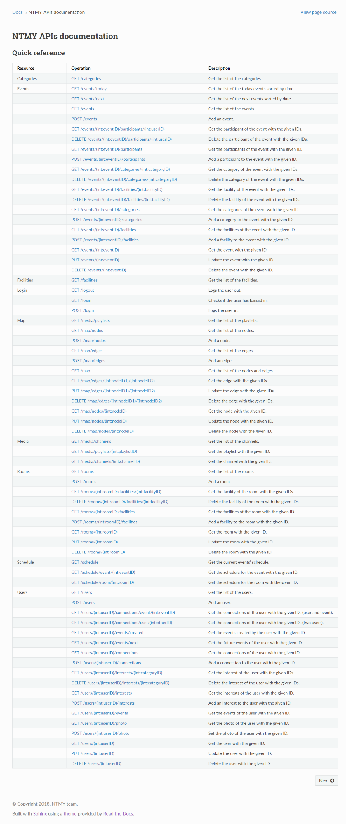
Main routes
/login
/users
/rooms
/events
/schedule
/media
/map
The full documentation is on the Github repository

Slide 14
Room clients
Matteo Corain

Slide 15
Room clients activities
Login into the server
Get the information on the next event
Set the lights with the events color
Set the music or TV player
Wait until the event is finished
Loop for the following event

Slide 16

Used libraries
Requests
Login phase and server information exchanging
Subprocess
OMXPlayer management
Philips Hue control
Pafy
Youtube music playlist fetch
TV channels fetch

Slide 17

Lights management
Philips Hue bulbs controlled via the HTTP REST API
All the interaction takes place in a LightManager object
The color is obtained from the events’ schedule
Possible to convert a RGB color with the rgb_to_hue function
Possible to set all or a subset of the lights in the room

Slide 18
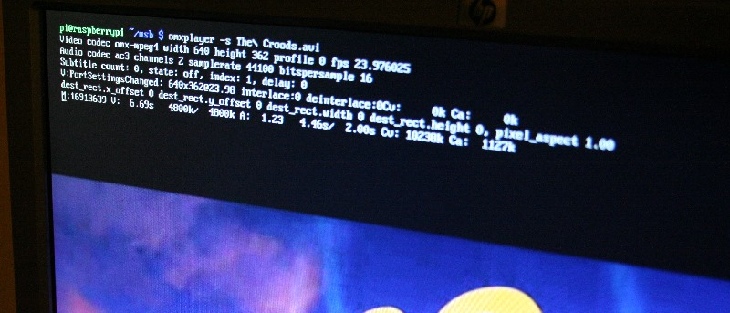
Media management
OMXPlayer is used as the player backend for its compatibility with Raspberry Pi boards, running as a subprocess
The interaction takes places in a Player object
TV channels (RAI) are fetched in m3u8 files faking the User Agent to the one of a normal browser
Music playlists are fetched in m3u8 files through pafy library

Slide 19
NTMY Android app
Andrea Cossio

Slide 20
Android app functions
Data storage
The server stores all the data regarging the users, the events and the rooms
Events navigation
The android application allows the user to navigate between all the future events, which are gathered from the database
Users connections
For each event, in addition to the basic infos, there is a list containing all the users met at that event.
Notes:
Our Android application has two main features: providing events navigation and listing users connections; both of these features rely on database requests.

Slide 21
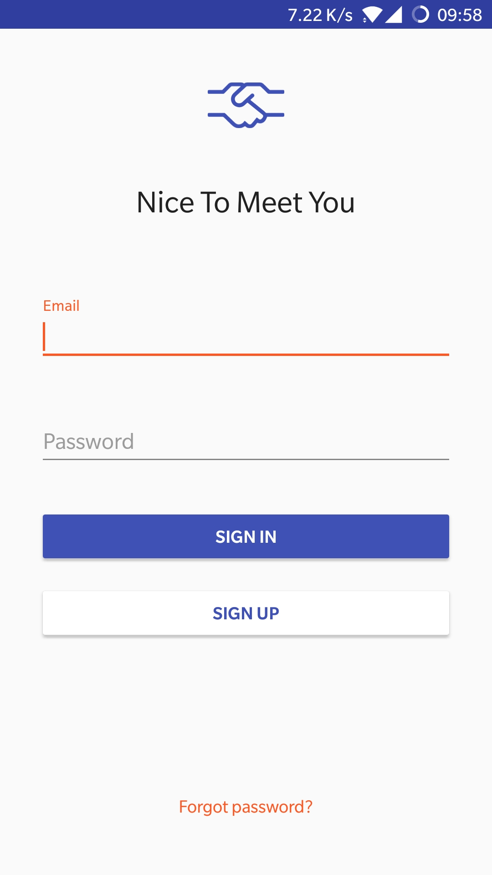
Login
The first activity that is displayed once the app is opened is the Login Activity
POST: /login
Notes:
The Login Activity is the first activity that the user comes across: login is necessary in order to access the API later. So, after a successful POST request to the API’s /login route the Main Activity will be displayed.

Slide 22
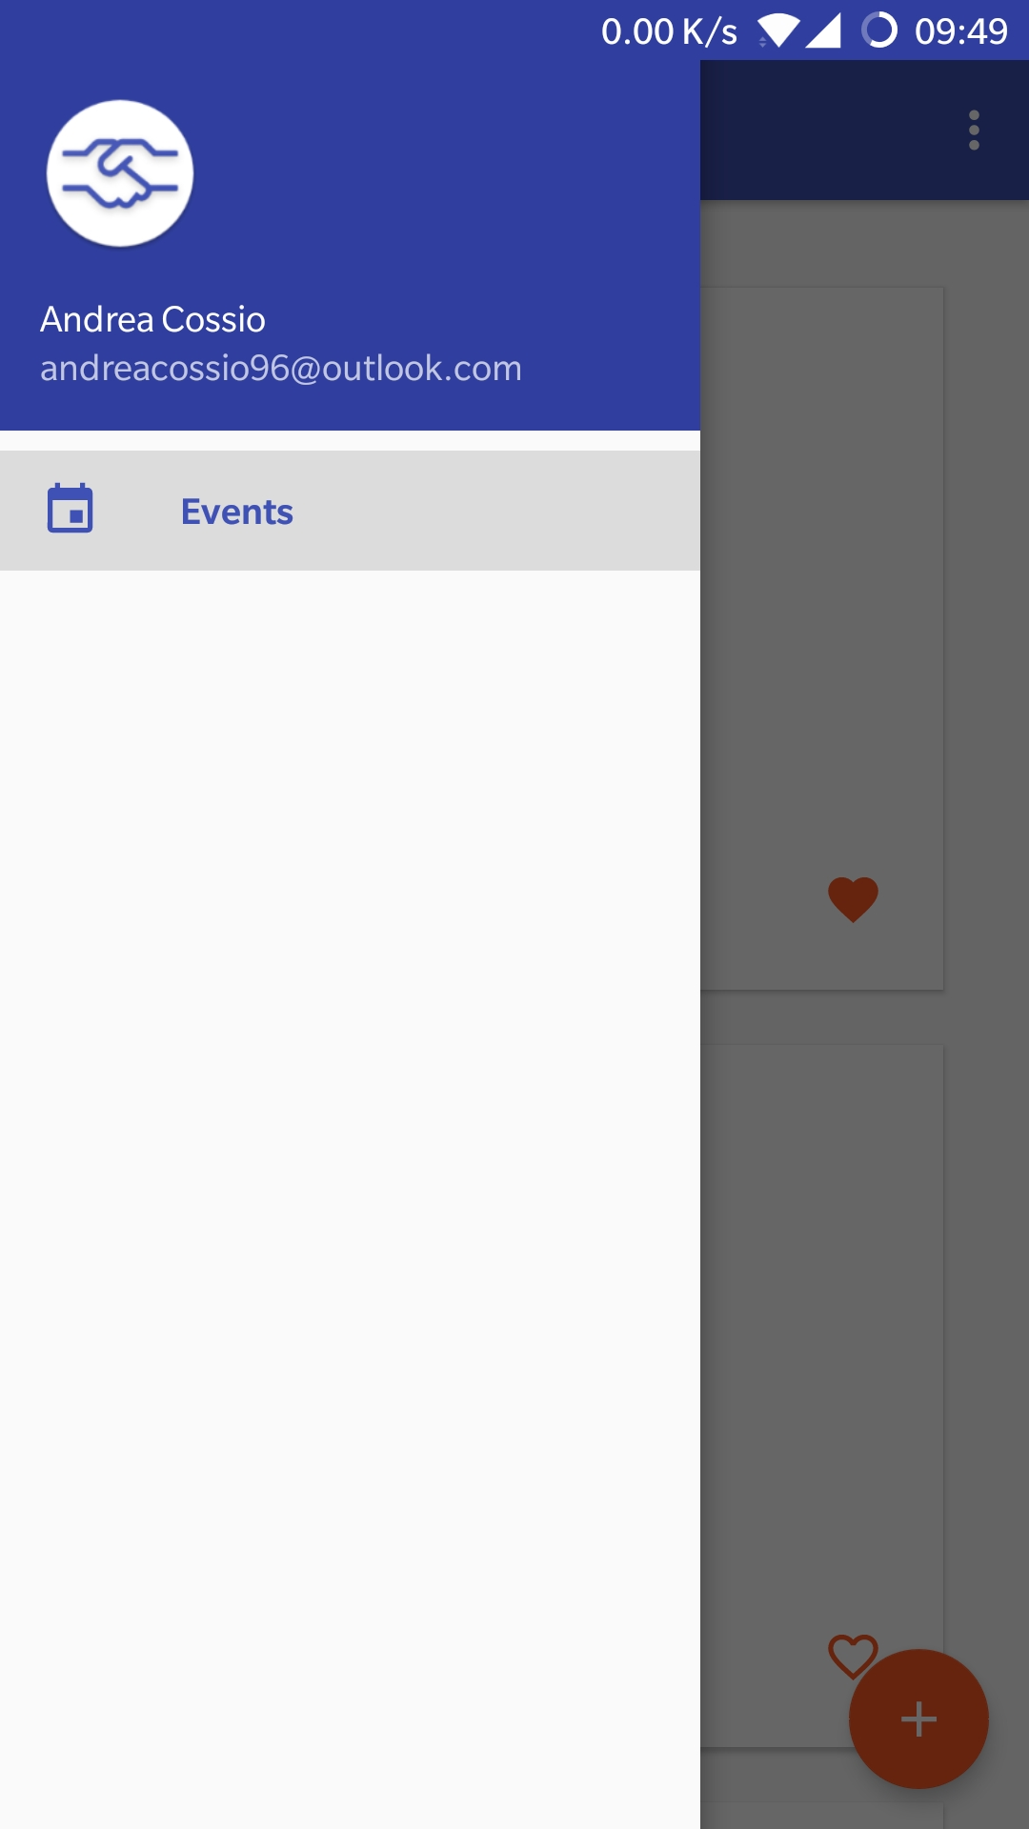
Main Activity
After a successfull login the Main Activity is showed
The Main Activity is a Navigation Drawer Layout that acts as a container for fragments
Notes:
The Main Activity is a Navigation Drawer Layout that acts as a container for the Main Fragment.

Slide 23
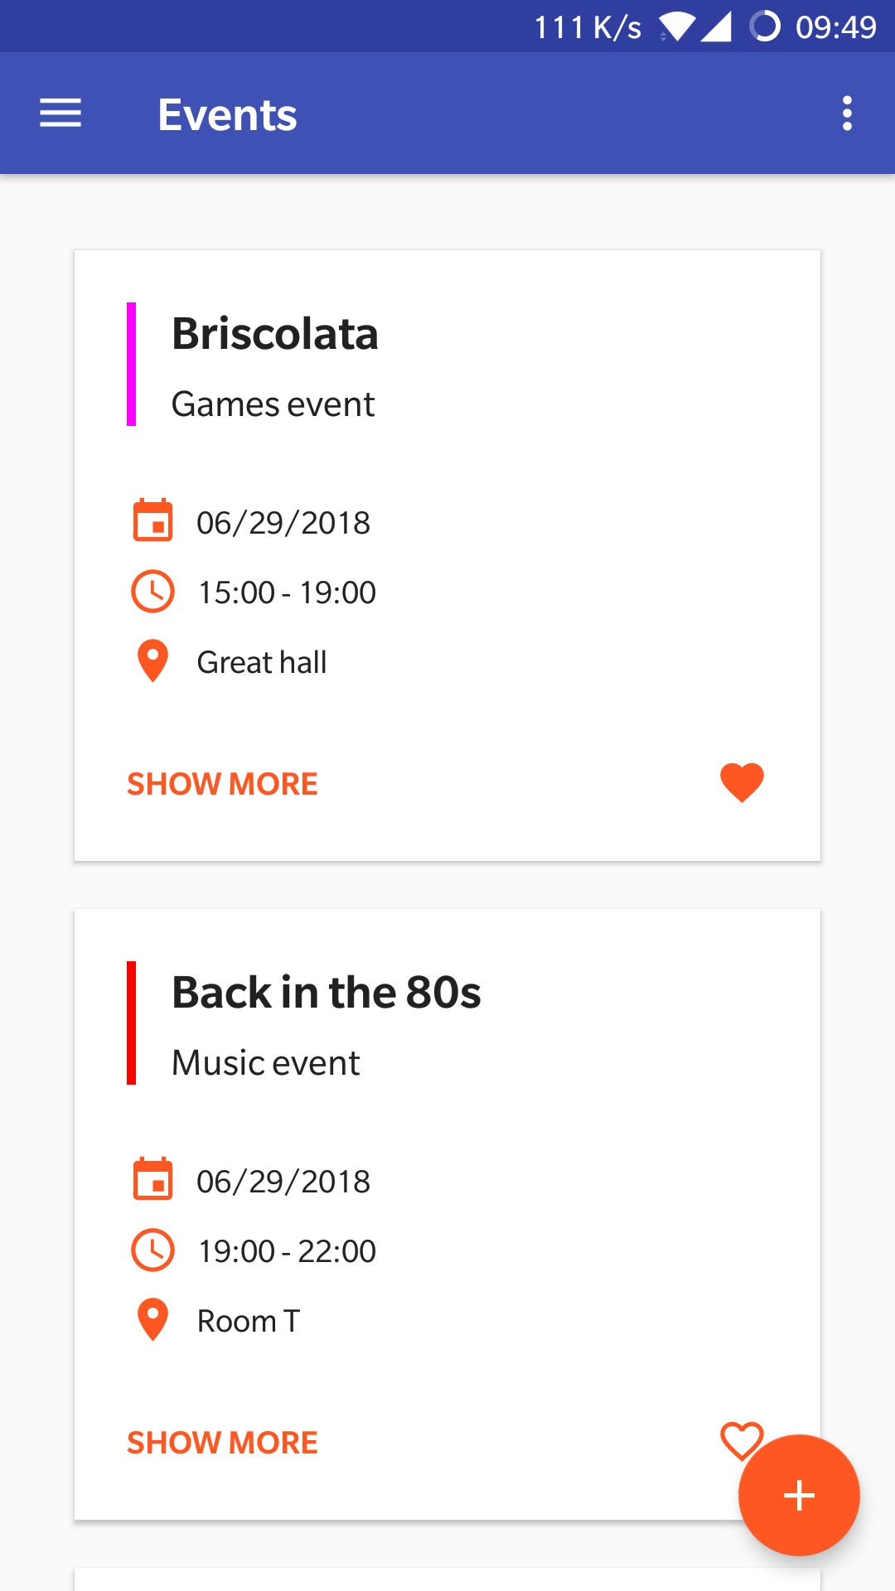
Main Fragment
Main Frament’s layout contains a RecyclerView that shows the future events list
GET: /events/next
Notes:
In the Main Fragment there is a RecyclerVIew that handles the display of the events; the list of events that are showed, is taken from the API’s /events/next route.

Slide 24
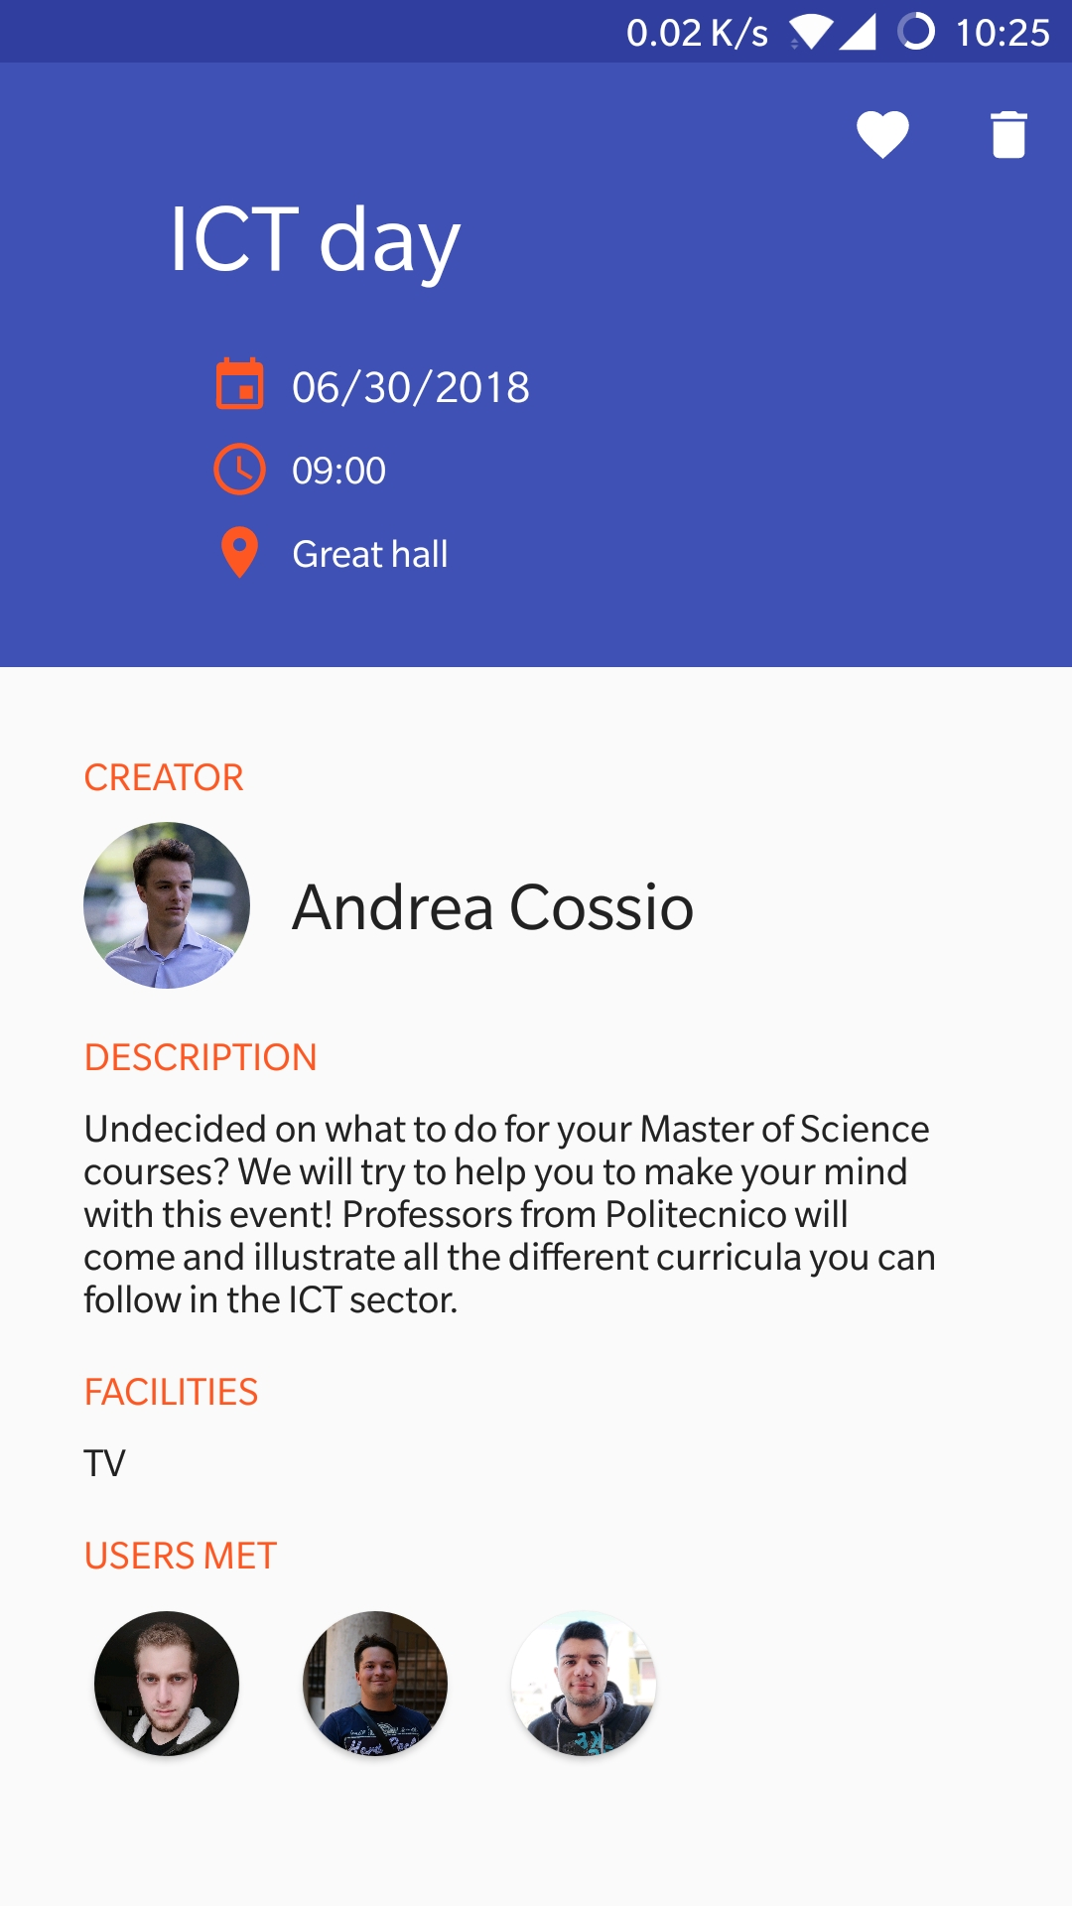
Event Activity
This activity shows detailed informations about the event
GET: /events/<id>
At the bottom there’s a RecyclerView that shows the users met
GET: /users/<id>/connections/event/<id>
Notes:
Each event in the Main Fragment is expandable to a new activity called Event Activity, that contains informations related to the event that the user clicked. This informations are gathered from the /events/<eventID> route. At the bottom of this activity there is the list of users met at the event (/users/<userId>/connections/event/<eventID>).

Slide 25
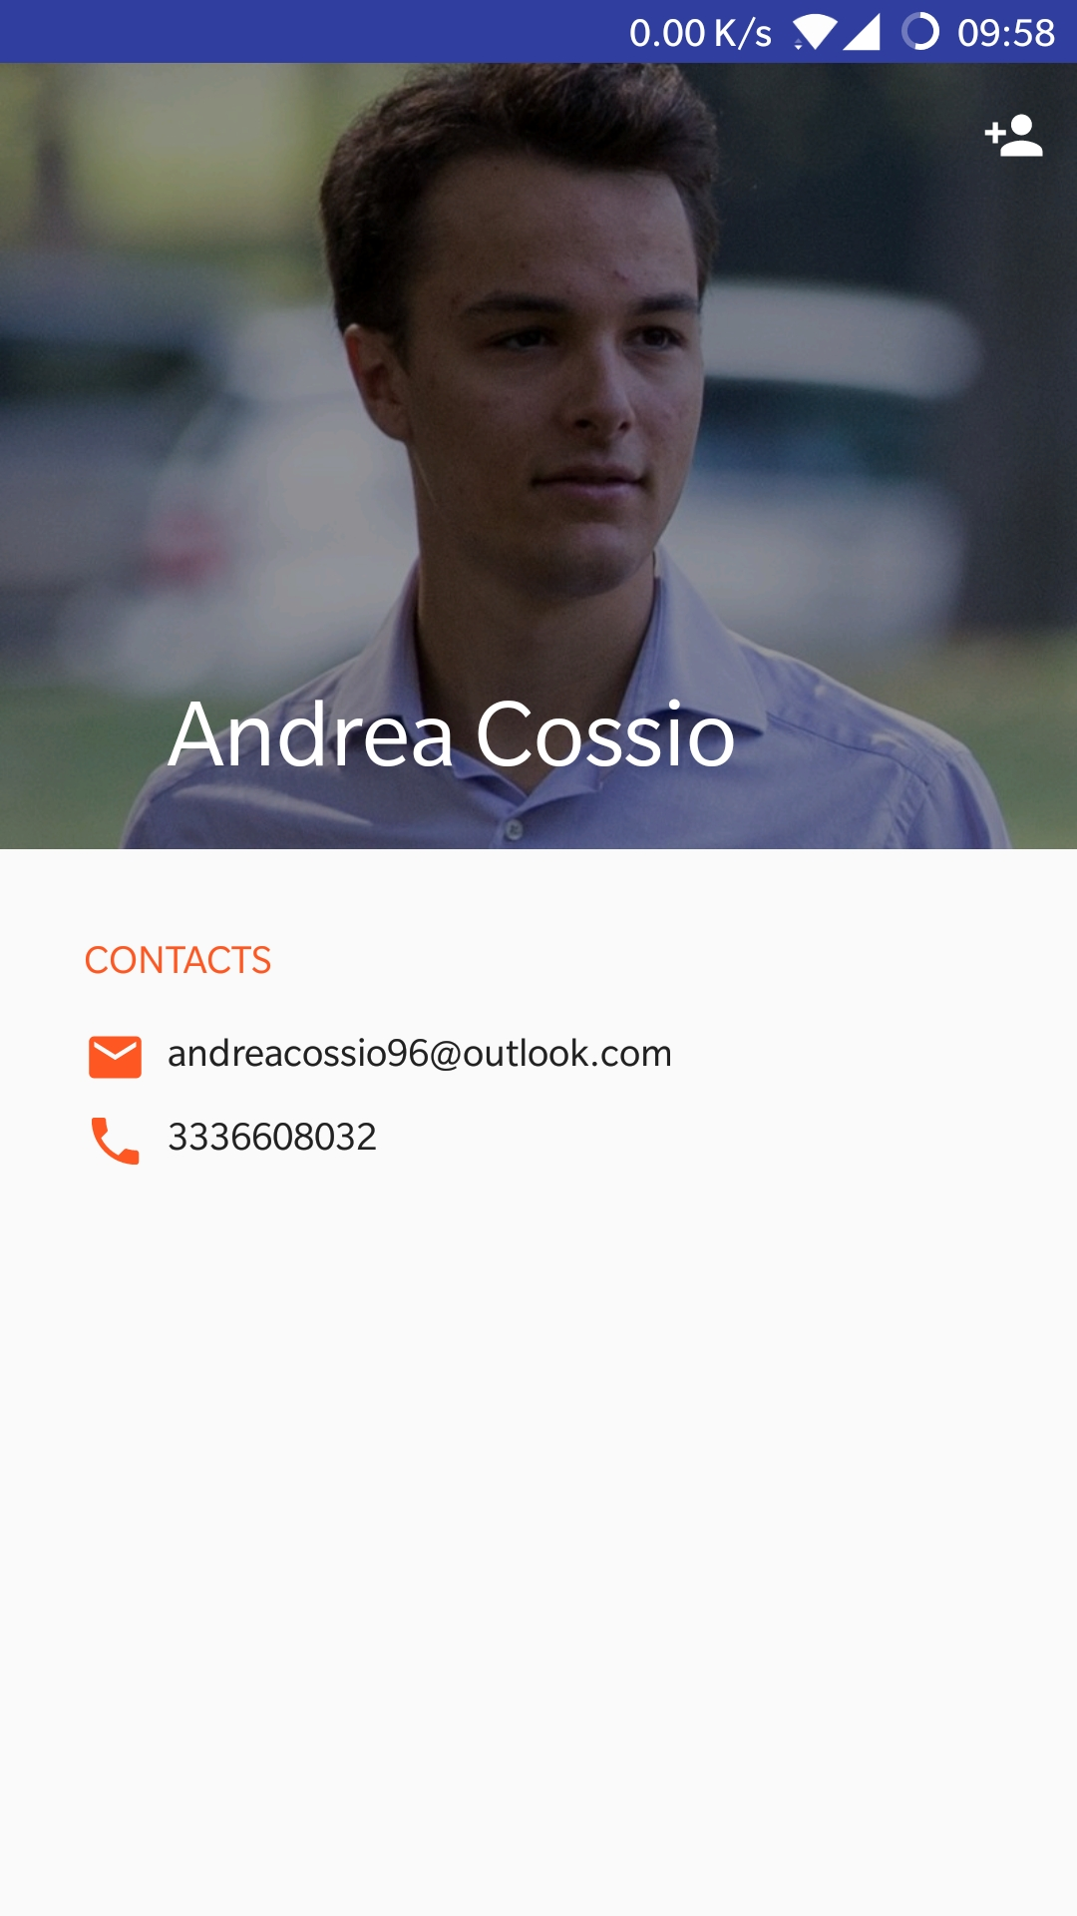
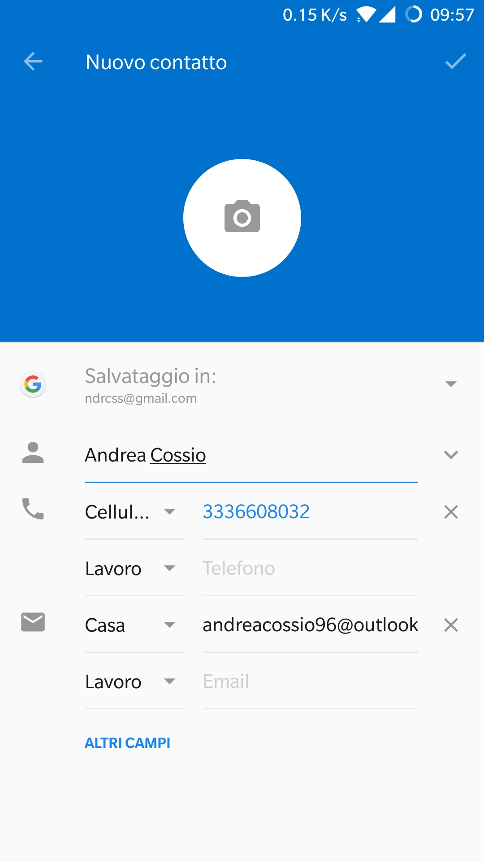
User Activity
Users are expandable as well, in order to see more detailed infromations about them
It is also possible to add the user as a contact
GET: /users/<id>
Notes:
All the profile images in this list are clickable, expanding the view to a new activity called User Acitivty. As for the events, the activity serve for listing more detailed informations, fetched from /users/<userID>. An important feature is the possibility to add the user as a contact.

Slide 26
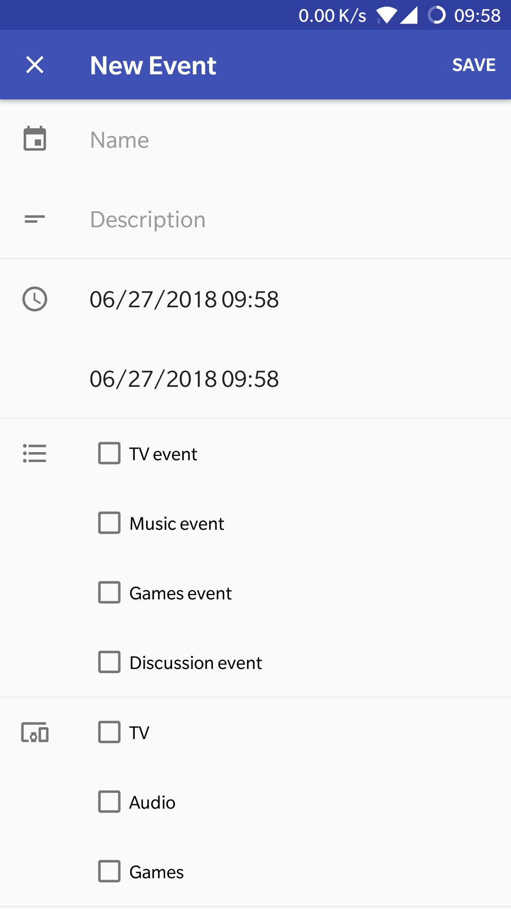
Add Event Activity
Among app’s features, there’s the possibility to create a new event
This activity is reachable from the Floating Action Button displayed in the Main Fragment
POST: /events
Notes:
One last important activity is the Add Event Activity, reachable via the Floating Action Button displayed in the Main Fragment: as the name suggests, this activity let the user create a new event and add it to the database.

Slide 27

Under the hood
To handle API requests we made use of Volley, an open source HTTP library for Android apps created by Google
When performing a request, in addition to the context and the path (and the JSONObject in case of POST requests), it’s necessary to pass two Listeners:
The Response.Listener<> which must contain the method onResponse, invoked when the request ends with a 200 OK
The Response.ErrorListener which must contain the method onErrorResponse, invoked when the request ends whit an error
Then, the request is added to the Singleton Queue of requests
Notes:
As I mentioned before, the application relies on API requests.

Slide 28
Implementation
Basic requests are implemented in the RequestHelper.java class
The image shows how a jsonObjectRequest is created and then added to the queue
url is the server’s IP

Slide 29
NTMY Wear app
Alessio Ciarcià

Slide 30
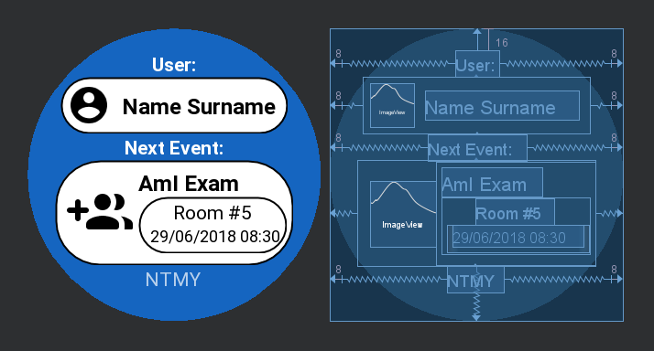
Step 1: Design
Once opened it shows:
User’s name and surname
Event’s informations
Event’s related color in the background.

Slide 31
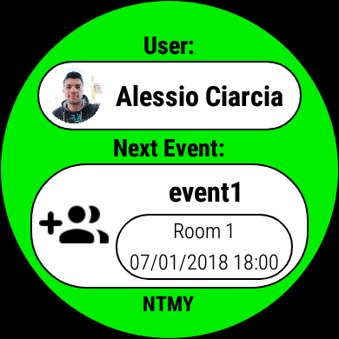
Step 2: Load data
When user runs the wear app:
Wear sends a message to the phone in order to obtain the data
If the phone is connected to the server (user logged) sends back the requested data and the wear update the layout with real data.
Otherwise if the phone can’t reach the server, the wear will shows the default data ( previous slide ).

Slide 32
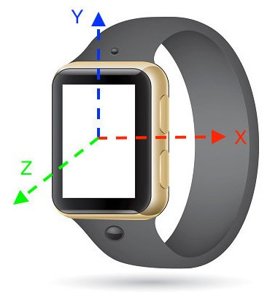
Step 3: Handshake Detection
Assumptions & limitations:
An handshake is here considered as a significant acceleration on wear’s Y axis.
The detection must be calibrated in order to not associate ordinary user’s movement to handshake.
On the other hand it must be sensitive enough not to lose any handshake

Slide 33
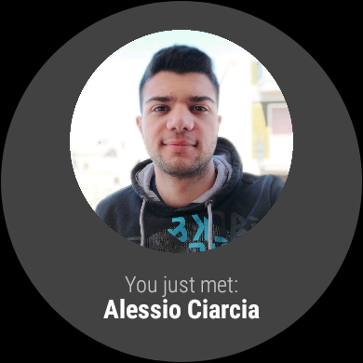
Step 3: Handshake Detection
Algorithm:
When an handshake is detected:
Check if is passed enough time since the last one.
Send a message to the phone.
The phone searches the other smartwatch (note: smartwatches only have «always detectable» enabled) and if it is found, phone sends back to the wear the data of detected user (smartwatch).
The phone will show a toast containing the user’s fullname.
Smartwatch instead will show user’s pic and fullname (right photo)

Slide 34
Routing
Alessio Ciarcià

Slide 35
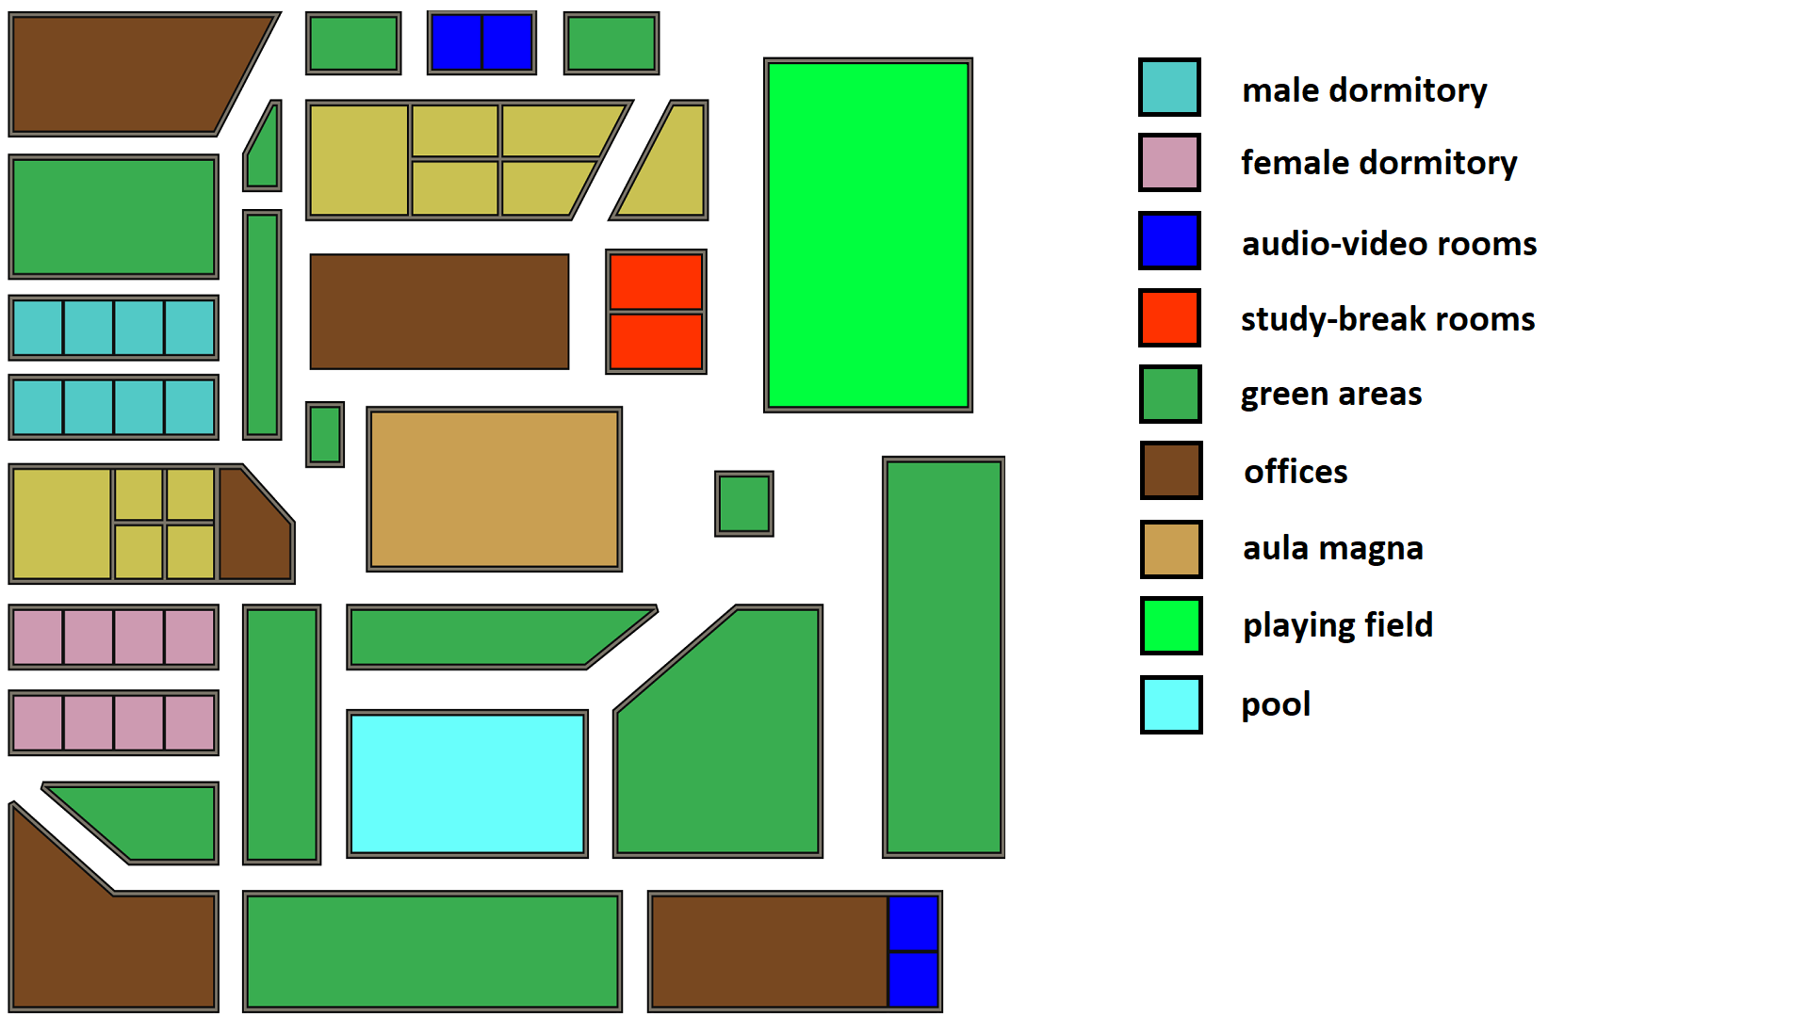
Step 1: Design college model
Our imaginary college has been designed taking into account that:
Bookable rooms are not all in the same location
The streets do not form a perfect grid so that the routing prediction is not trivial.

Slide 36
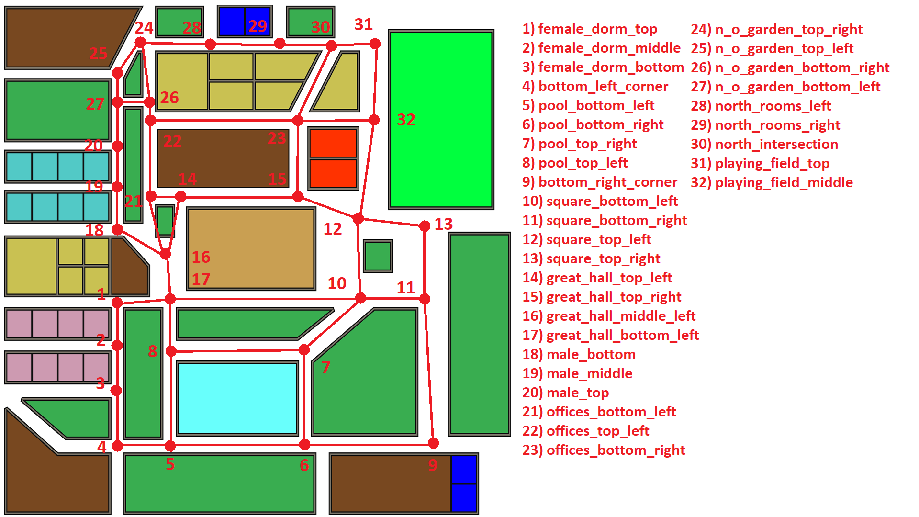
Step 2: Graph model
From the college model was built a graph over it:
There are 32 nodes covering almost all the crossroads.
In each nodes there is a direction panel.
A node has at most 4 edges => 4-directions panel

Slide 37
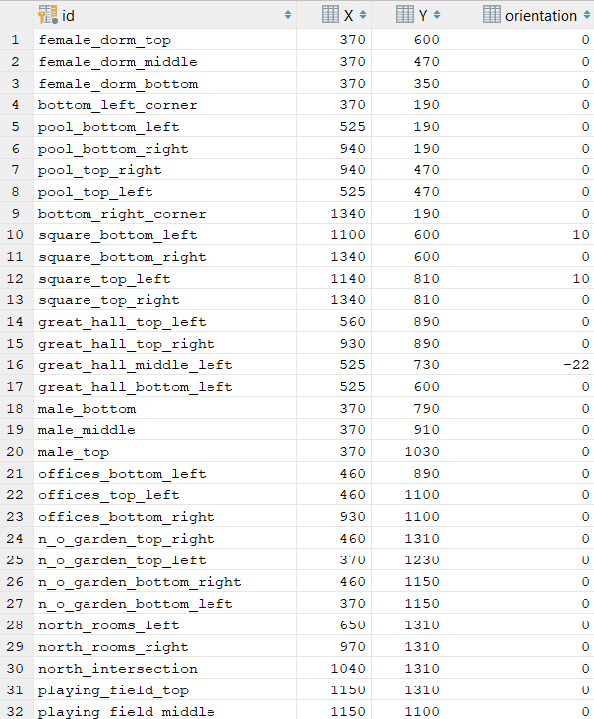
Step 3: Programming
Process: Database creation.
The database contains two tables, one for nodes and another for edges.
Each node has a string identifier, coordinates and panel orientation (since not all the crossroads have orthogonal intersections or not all the streets are aligned with cardinal axes.
Each edge tuple contains the two nodes id and the length of associated stretch of road

Slide 38
Step 3: Programming
Process: Graph creation.
Load edges and nodes data from the server.
With the use of Networkx module create the graph and add all nodes and edges.

Slide 39
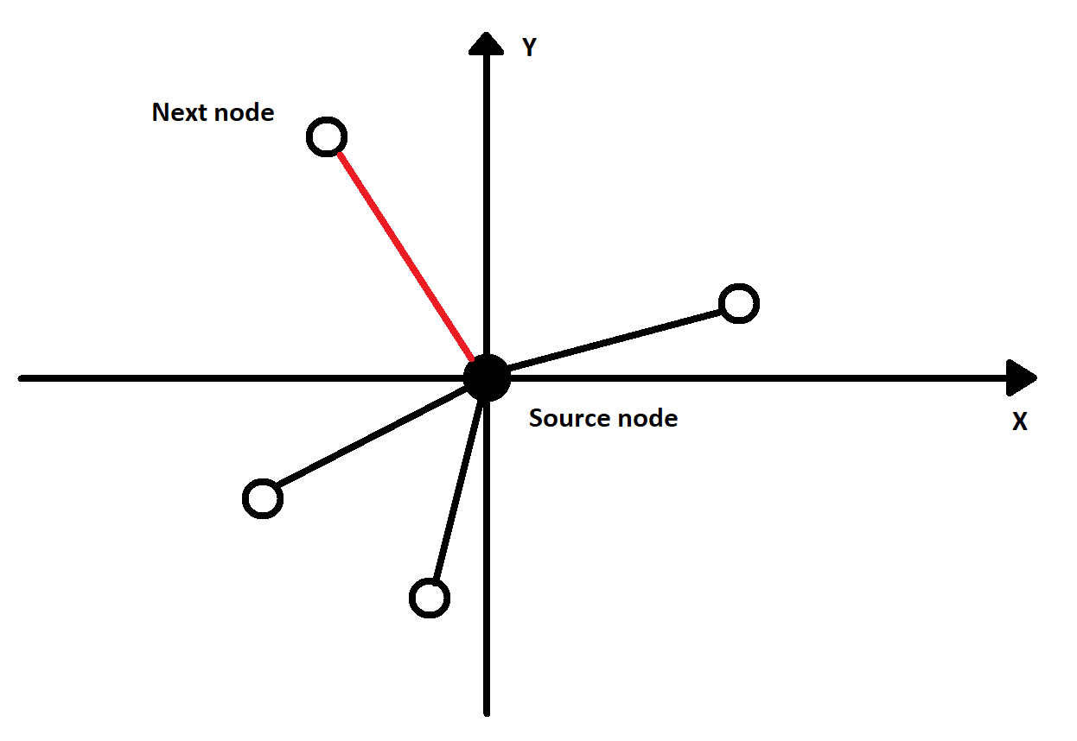
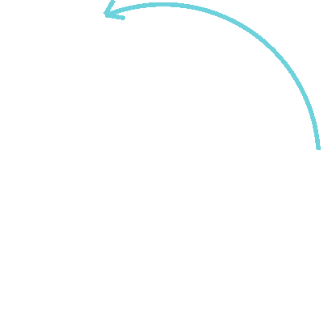
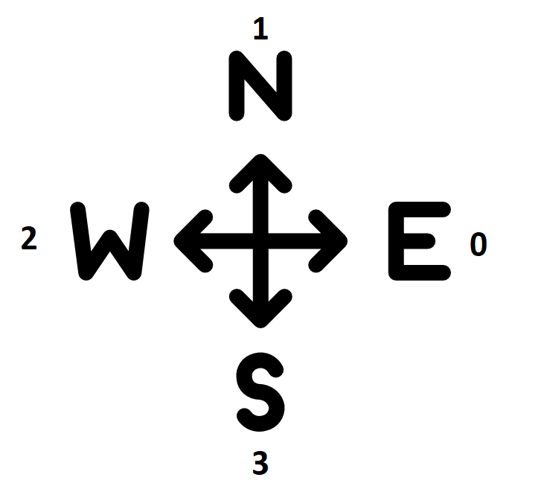
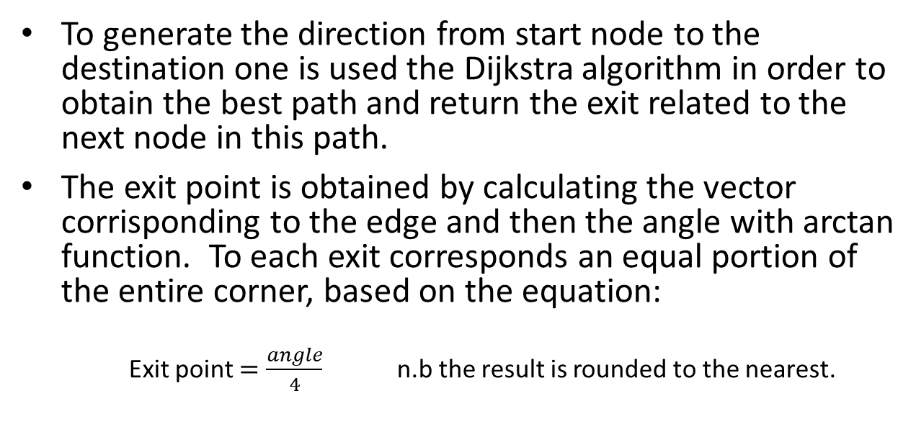
Step 3: Programming
Process: Strategy.
To generate the direction from start node to the destination one is used the Dijkstra algorithm in order to obtain the best path and return the exit related to the next node in this path.
The exit point is obtained by calculating the vector corrisponding to the edge and then the angle with arctan function. To each exit corresponds an equal portion of the entire corner, based on the equation:
Exit point $=\frac{angle}{4}$ n.b the result is rounded to the nearest.

Slide 40
Smart Panels
Raffaele Tuzzo

Slide 41

Specifications
To achieve the Smart Road Sign, a panel that can provide the event’s direction when a user nearby is detected:
We need a configuration to sign all the 4 cardinal direction
2. We want to set a color to the arrow, according to the event’s color

Slide 42
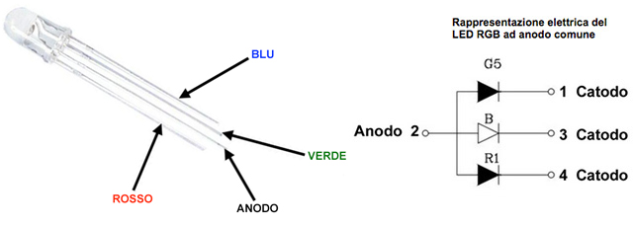
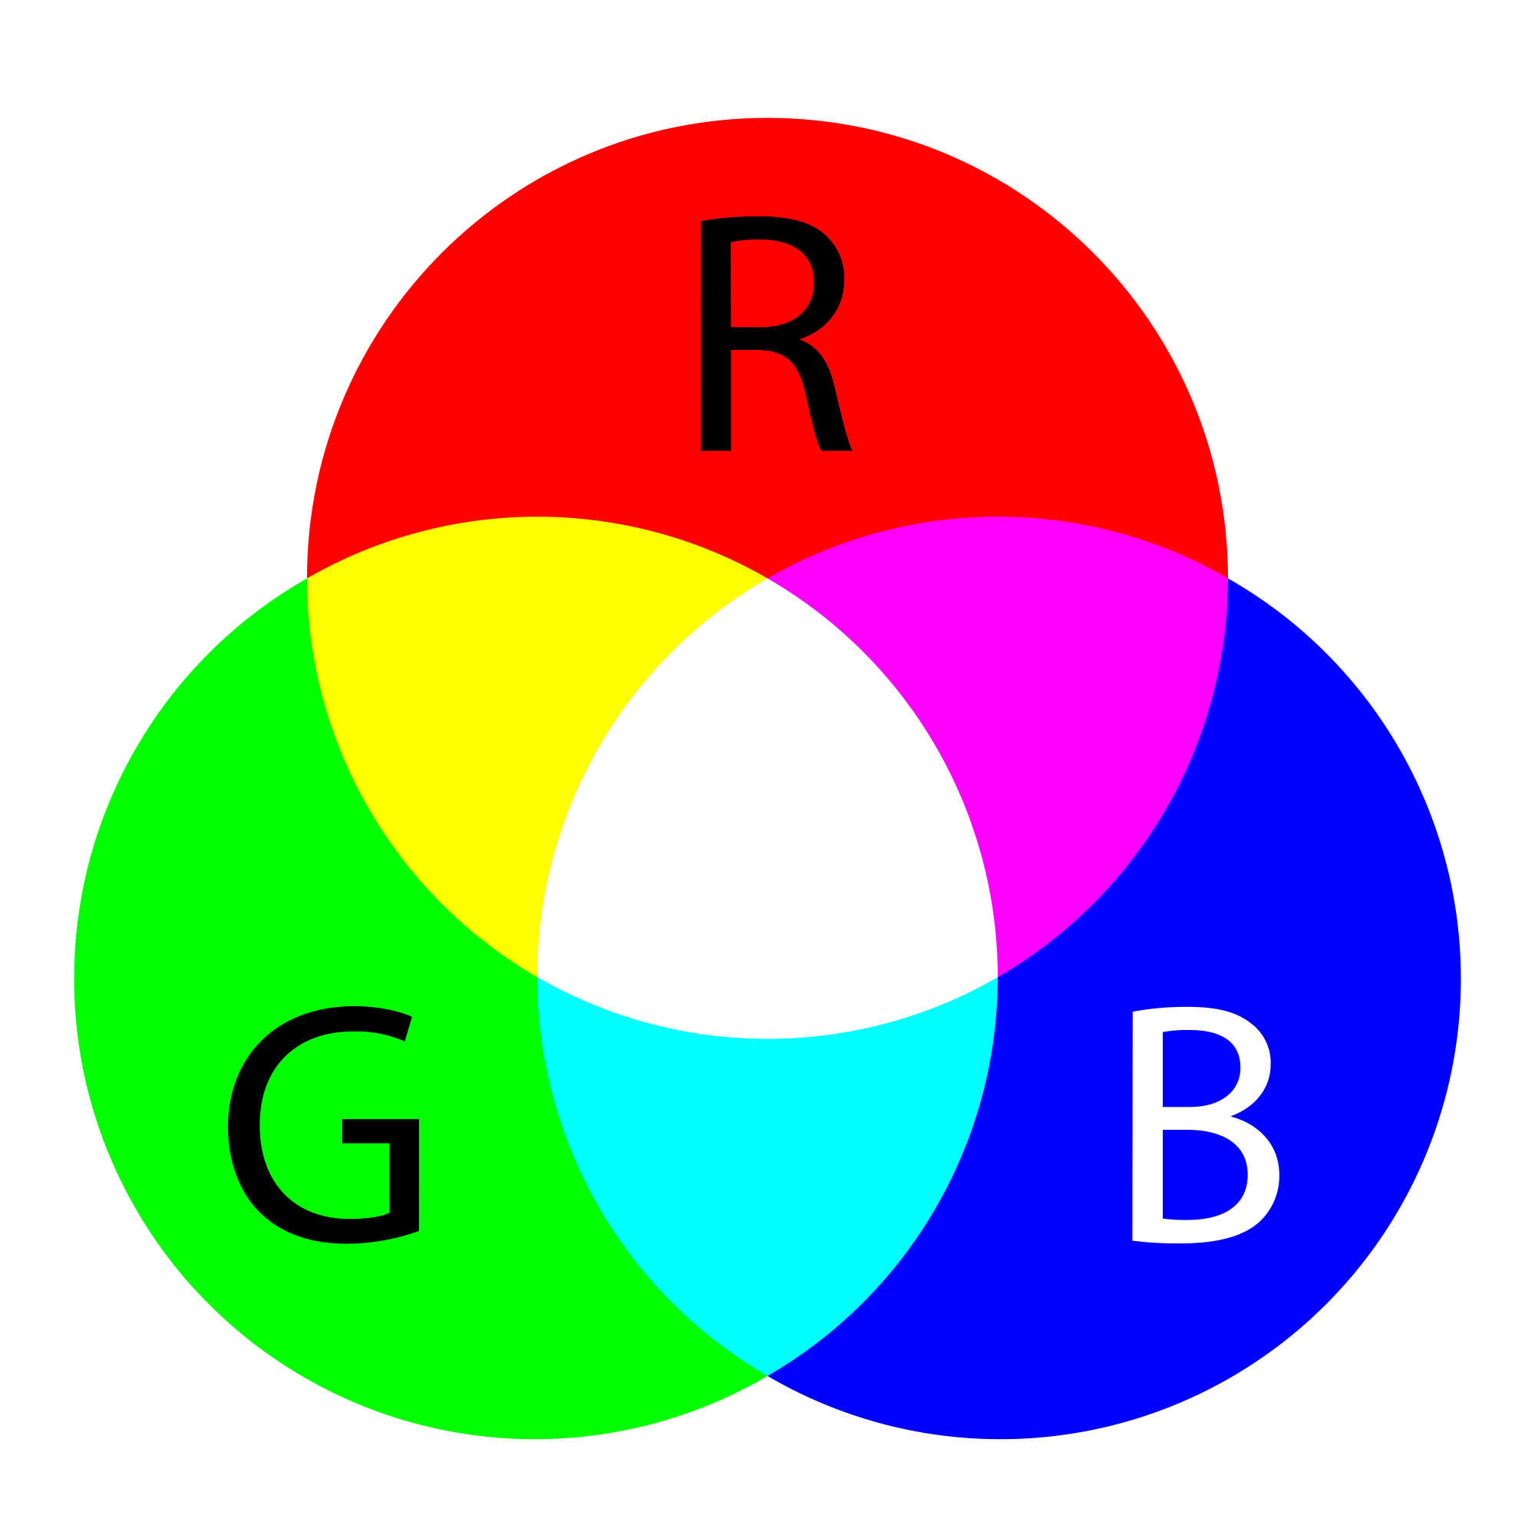
Solutions
Leds
We can use 8 Leds, set up in a rhombus scheme to represent the 4 possible arrows.
To set every possible color we can use RGB Leds, setting a color by the right combination of Red, Green and Blue.
c
Cathode R
Cathode G
Cathode B
Anode

Slide 43
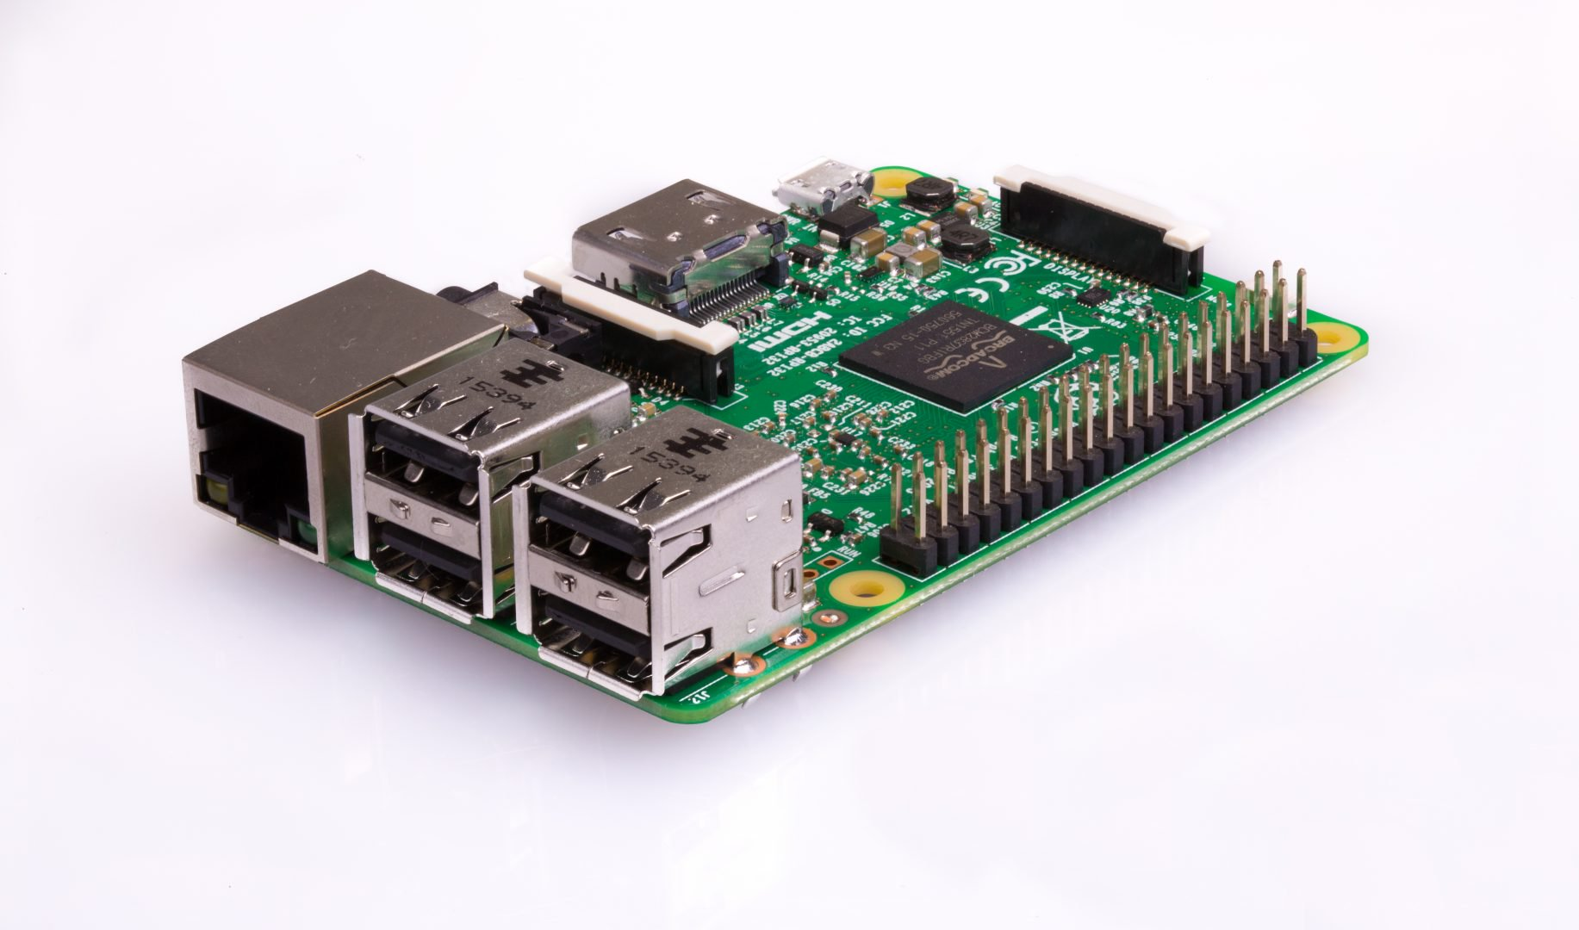
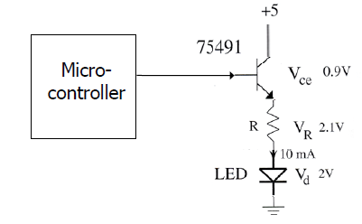

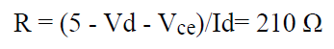
How to drive leds
We used a Raspberry PI 3 ( B model ) as Micro-controller.
To drive a single led we chose a buffer in an Open Emitter configuration, using npn transistors.
Now we can switch a led, the npn works in saturation (ON) and in interdiction (OFF) mode.
Rb
Rb = 1 Kohm ( to work in sat/int )

Slide 44
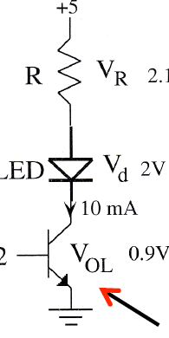
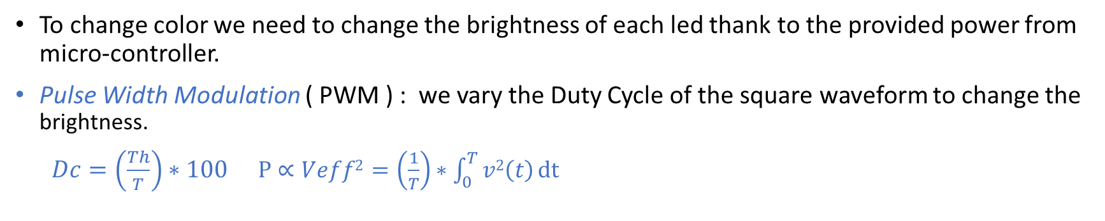
Color set up
To change color we need to change the brightness of each led thank to the provided power from micro-controller.
Pulse Width Modulation ( PWM ) : we vary the Duty Cycle of the square waveform to change the brightness.
$Dc=\left(\frac{Th}{T}\right)∗100$ $P∝Veff2$ $=\left(\frac{1}{T}\right)∗\int_{0}^{T}{v2\left(t\right)}dt$
T
npn used as buffer in Open Collector configuration
Raspberry PI pinout: - VOH = 3.3 V
- VOL = 0 V
µ controller
.
Th
Rb

Slide 45
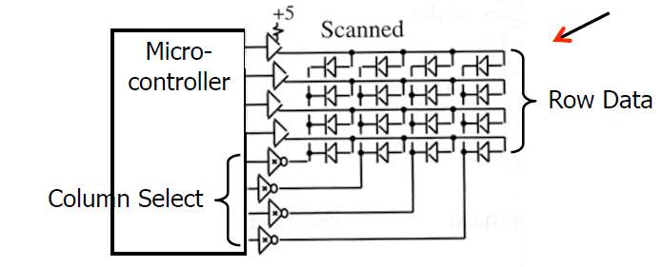
General Configuration
We have in total 24 leds to drive, so we need 24 pins for leds , 1 pin for supply voltage and 1 pin for the ground. It’s too much!
We can use the Scanning Multi-LEDs Interface:
C
R
We set up leds in a matrix configuration 8 x 3
8 Rows: npn in OE buffer to switch leds ON/OFF
3 Columns: npn in OC buffer to drive the software pwm

Slide 46
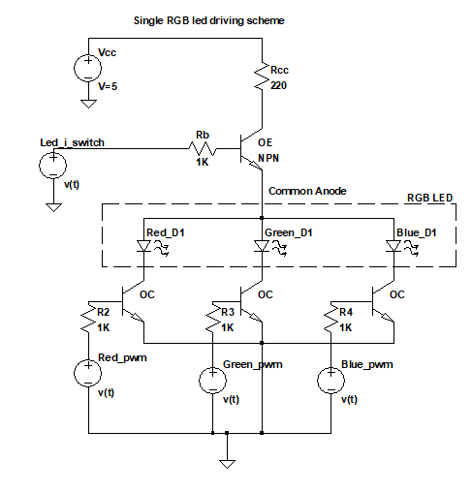
Single RGB led scheme
So, each RGB led is driven by two different buffer:
Open emitter to control ON/OFF ( Row )
3 Open collector to the pwm of the colors ( Columns )
Note:
Vcc is the voltage provided by the DC voltage pin by the Raspberry.
Other voltage generators represent the square waveforms provided by GPIO pins of the Raspberry (pwm in software mode).

Slide 47
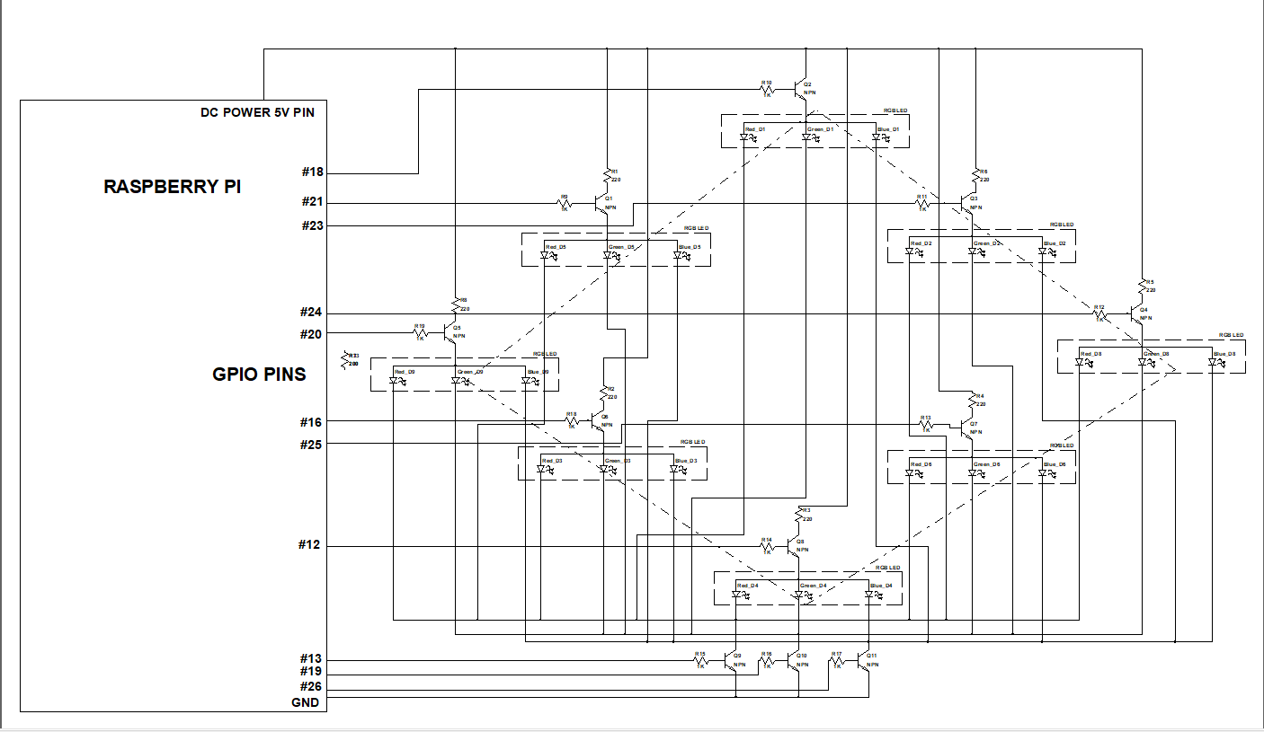
Panel - General Circuit Scheme
MATRIX 8 x 3
R G B
L0 x x x
L1 x x x
L2 x x x
L3 x x x
L4 x x x
L5 x x x
L6 x x x
L7 x x x

Slide 48
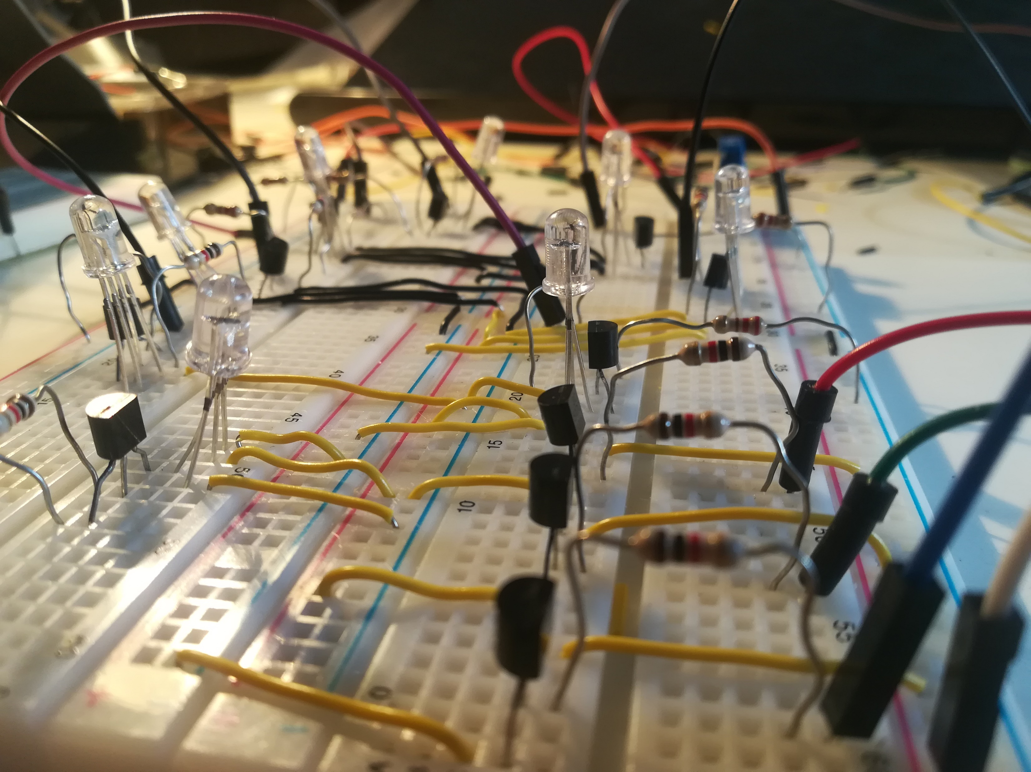
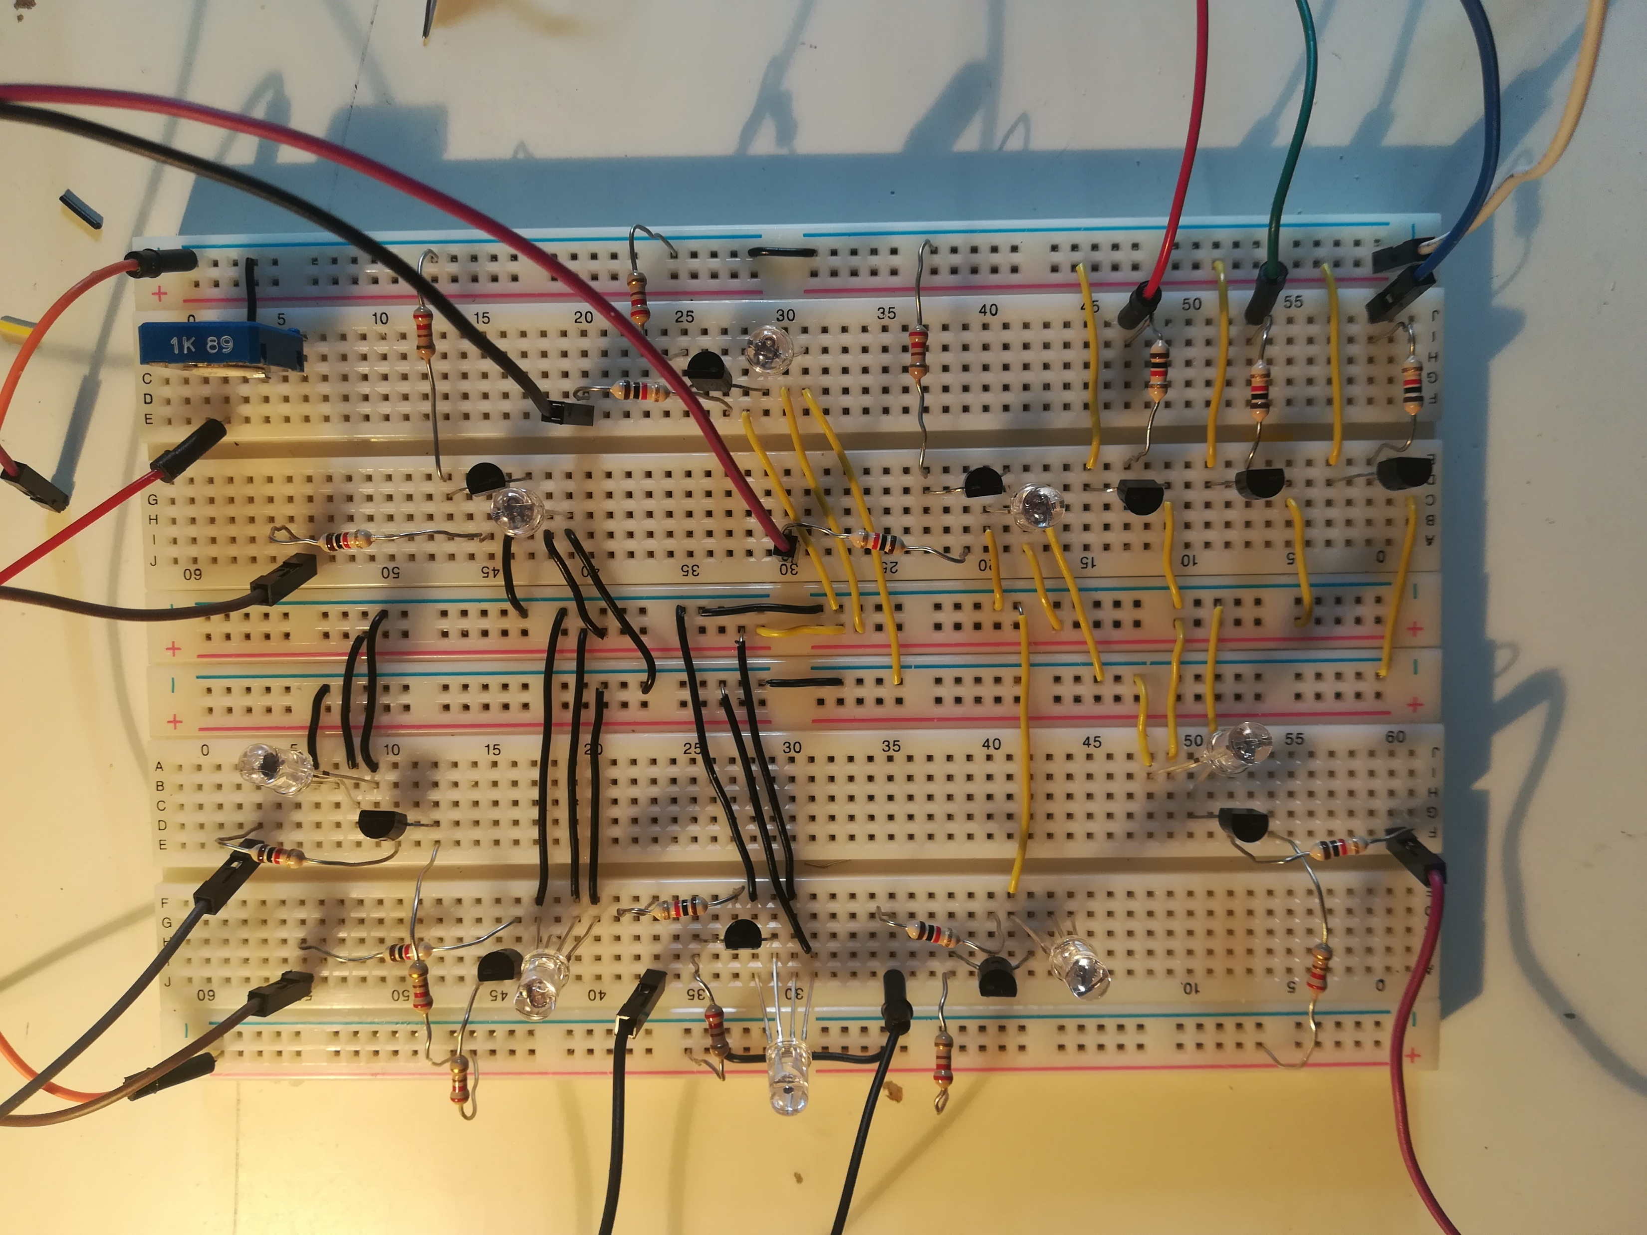
Circuit Overview

Slide 49

Software interface
The Smart Panel must work in 2 mode:
Stand-by -> All led are ON, drived with a continuous variable pulse modulation, when no user is detected [ light_standby () ]
Light-Arrow -> Only 5 leds are ON to create the wanted arrow, with the
corresponding event’s color.
This function also regulates the right color introducing some
correction factors to balance the intensity of each color led,
creating a blinking effect.
[ light_arrow( int direction, float R, float G, float B) ]
To semplify the interface’s code is used the python library « gpiozero » for the pin assignment and for pulse and blink sub-functions.
The panel works in continuous loop, between this 2 mode.
The user is detected thank to a continuos bluetooth scan by the Raspberry.

Slide 50
Demo time!
NTMY team

Slide 51
What you’ll see today
Event creation and joining
Room preparation
Directional panels
NTMY action

